Slide 1
The Zen of Coding

Slide 2
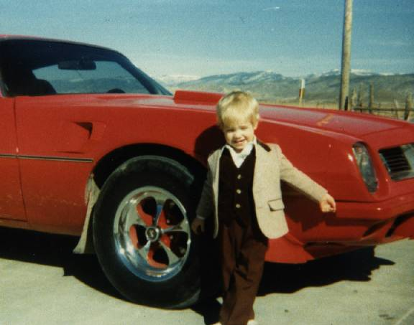
Jared Nielsen
20 years teaching + webdev
Grew up in rural Utah
Taught wilderness survival
Notes:
http://jarednielsen.com/pictorial-st-louis/

Slide 3
Go!
Who are you?
Where are you from?
What’s your background?
Why are you here?
Fun fact?

Slide 4

Goals

Slide 5
The Path of Learning
Notes:
We’re here to teach you how to teach yourself.

Slide 6
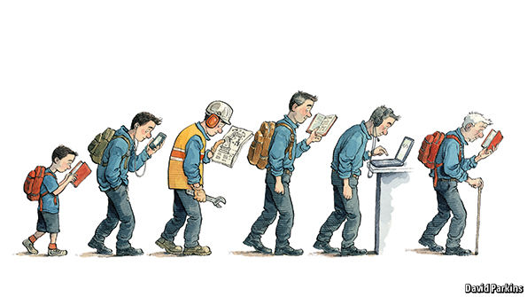
Lifelong Learning

Slide 7

What is Code?

Slide 8
The Keys to Success

Slide 9

Mindset

Slide 10
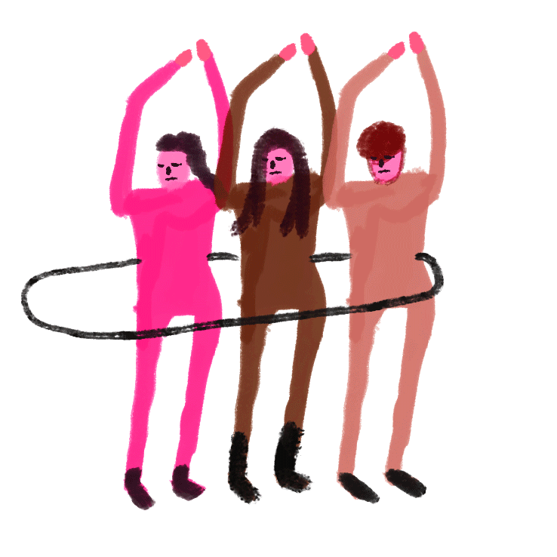
Teamwork

Slide 11
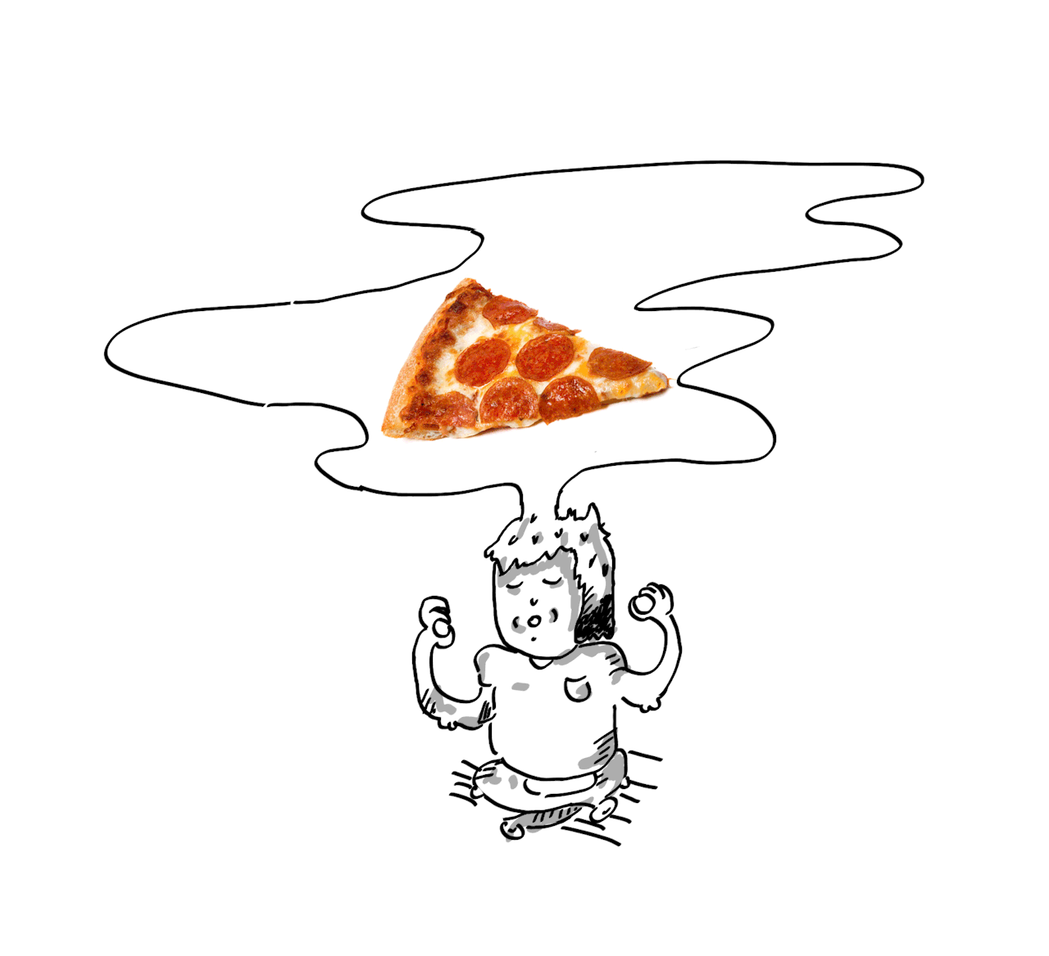
Focus

Slide 12

Google Fu

Slide 13
On the Modern Web

Slide 14
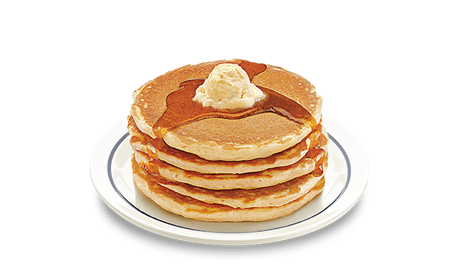
What is Full Stack Development?
Notes:
YouTube

Slide 15
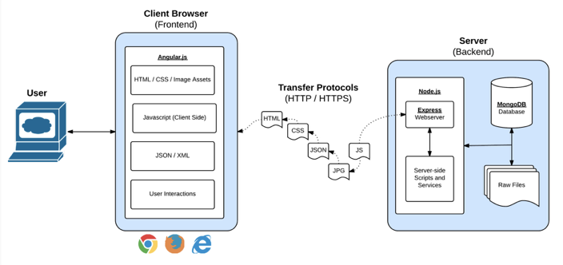
Front End, Meet Back End. Back End, Front End.
Notes:
In modern web apps, there’s a constant back-and-forth communication between two key components: the visuals displayed on the user’s browser (frontend) and the data and logic stored on the server (backend).
Full-Stack Development is the concept of building every aspect of the web application – from the visuals and interactions, to the data transfer and processing.

Slide 16
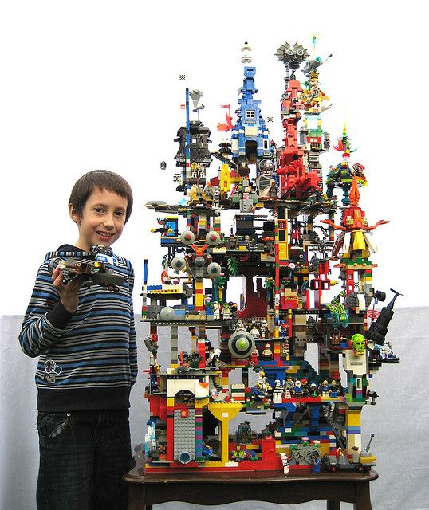
Building Blocks

Slide 17
Course Structure

Slide 18
Daily Schedule
Set objectives
Lecture
Demo(s)
Discussions
In-class exercise
Homework and projects

Slide 19
Weekly Schedule
Homework
AND/OR
Project (Individual or Group)

Slide 20
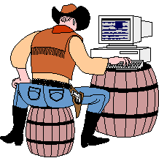
Learning to Code Requires Coding

Slide 21
Pre-Work

Slide 22
Checklist
Slack
Sublime Text 3 (or Atom)
Git
CLI
Git Bash (Windows)
Terminal (Apple)
Node.js
Heroku
Chrome

Slide 23
Accounts
GitHub
GitLab
Heroku
LinkedIn
Stack Overflow

Slide 24
Test
Open Sublime
Open Git Bash or Terminal
node -v
git --version
heroku --version

Slide 25
In the Beginning was
the Command Line...

Slide 26
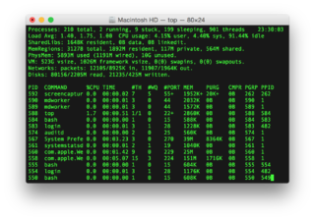
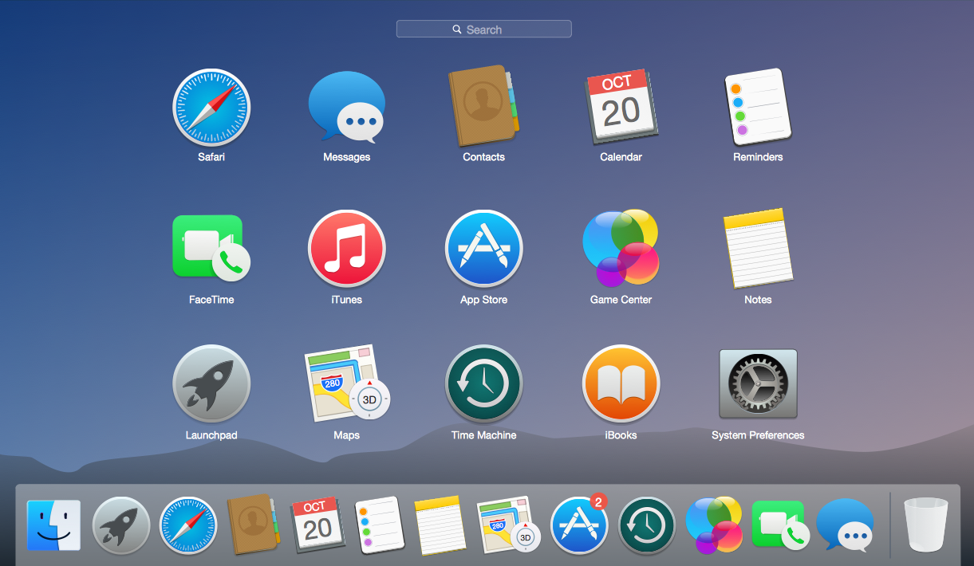
CLI vs. GUI

Slide 27
Files
touch
ls (list)
open (Apple), explorer (Windows)
cat (concatenate)
rm (remove)

Slide 28
Directories
pwd (print working directory)
mkdir (make directory)
cd (change directory)
cd .. (move up)
cd ~ (go home)
open . (Apple), explorer . (Windows)
rm -r (remove directory)

Slide 29
RTFM
man (manual)
Tab
Up/Down

Slide 30
Go!
From the command line:
Make a new directory titled: first_day_stuff
Change into first_day_stuff
Create a file titled: first-day.html
Open first_day_stuff
Bonus
In one command, make multiple directories titled: dir_one and dir_two
In one command, create multiple files: one.html and two.html

Slide 31
Find a Friend
Friend on the right, explain:
How to make a directory
How to change into a directory
How to create a file
How to open directories and files
Friend on the left, answer:
What is Full Stack Web Development?

Slide 32
Hello, HTML!
Notes:
https://media.giphy.com/media/10UiTwBCmGEEw0/giphy.gif

Slide 33
Go!
Create my-first-web-page.html, and include the following:
DOCTYPE declaration
head tag with a title tag
h1 tag with a heading of your choice
Embed an image
Add three links:
One standard
One that opens in a new tab
One that is a bold placeholder
Bonus
Use an alternative way of separating links without line breaks
Create an ordered list of steps to make a sandwich
Create an unordered list of your favorite bands
Embed a YouTube video of one of your favorite songs
Notes:
https://media.giphy.com/media/10UiTwBCmGEEw0/giphy.gif

Slide 34
Lunch

Slide 35
The Zen of Coding?

Slide 36
Git?

Slide 37

Git!
What?
Organized system for managing code
Allows multiple developers to collaborate
Why?
Strict system for resolving conflicts
Version history
See also:
GitHub
GitLab

Slide 38
Find a Friend
Friend on the left, explain version control
Friend on the right, explain why we use version control

Slide 39
First Commit, er... Steps, with Git

Slide 40
Basic Git Commands
git clone (copy a repo)
git add (add file(s) to the repo)
git commit (notes changes to the repo)
git push (send changes to GitHub or GitLab)
git pull (update repo locally)

Slide 41
Go!
Using GitHub and the command line:
Create a new public GitHub repo, initialized with a README
Clone the repo to your laptop
Create an HTML file in the local rep directory
add, commit and push the repo to GitHub
Bonus!
Find a friend in class and fork their repo
Clone this fork to your laptop
Create an HTML file in the repo
add, commit and push
Submit a pull request to your friend’s repo

Slide 42
Homework
Review
my-first-web-page.html
Watch the HTML video (see Slack for link)
command line
git commands

